Slide 1












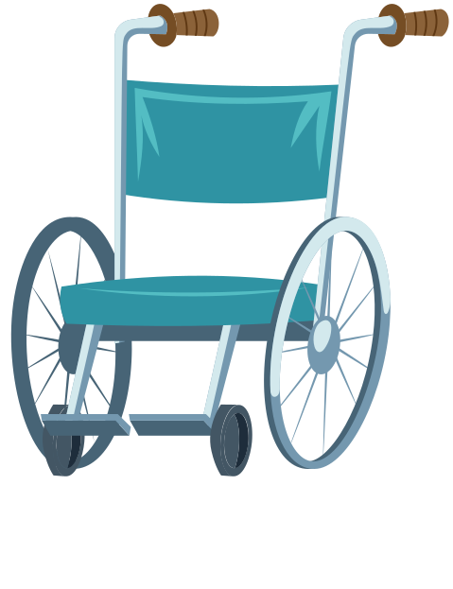
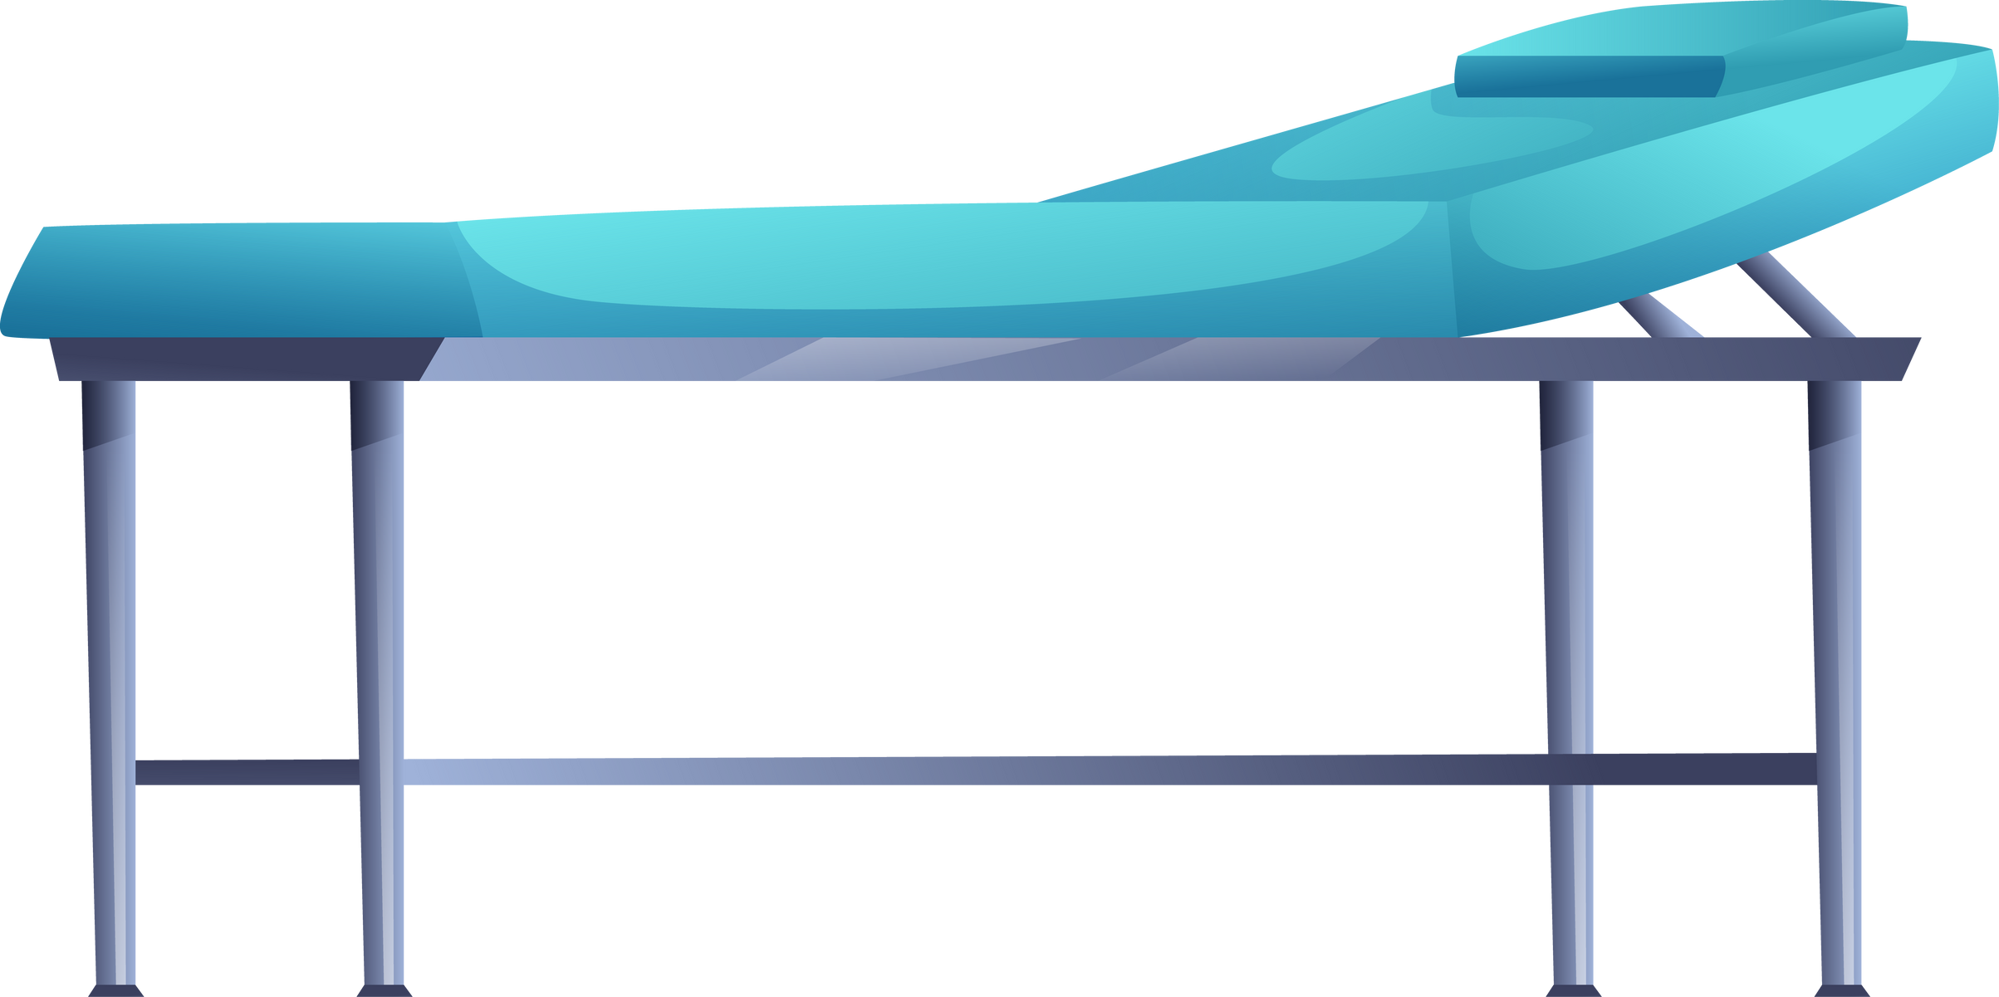



PROPOSAL
FOR ESTABLISHING
General Mobile Clinic Service

Slide 2



PROPOSER’S IDENTITY
Company Name:
Address:
Responsible Person:
Contact Person:
E-mail:

Slide 3


BACKGROUND
Health is a basic necessity for the community that must be accessible to all layers of society, including those in remote areas or those difficult to reach by permanent healthcare facilities.
The Mobile Clinic emerges as an innovative solution that allows basic health services to be delivered directly to the community via a vehicle equipped with standard medical equipment.

Slide 4


PURPOSE
  To provide basic health services in areas that are difficult to reach by permanent medical facilities.
  To provide general check-up services, minor treatment and community health education on a mobile basis.

Slide 5

MOBILE CLINIC SERVICE PROFILE
These Mobile Clinic Services are designed to serve the community using a single vehicle unit modified as a traveling clinic.
Each unit will be operated by one driver, one general practitioner (GP) and/or one nurse, supported by standard medical equipment and a simple electronic record-keeping system.

Slide 6


Operational Planning
  The services are provided through a scheduled visit system to homes/villas.
  Operational hours: 5 working days per week (Monday-Friday).
  Types of services include: general check-ups, minor wound care, blood pressure measurement, blood sugar testing, and health education.

Slide 7


EQUIPMENT LIST & ESTIMATED INVESTMENT COST
Based on initial planning, the required medical equipment and logistics for 1 (one) General Mobile Clinic unit, staffed by 1 doctor and 1 nurse, are listed in the attached table (Excel file).
The estimated total cost for equipment procurement is approximately IDR.25,000,000 – IDR.30,000,000, depending on the brand and specifications of the tools used.

Slide 8
CONCLUSION
Thus, we submit this proposal as an effort to support the improvement of direct and sustainable healthcare services.
We hope for the support and collaboration of various parties so that the Mobile Clinic program can run effectively and provide real benefits.
Yours sincerely,

Slide 9

MEDICAL EQUIPMENT LIST
Equipment Name | Category | Quantity | Unit | Price (Rp) | Remarks/Description | Total (Rp)
Stethoscope | General Examination | 1 | Unit(s) | 300.000 | For patient examination | 300.000
Digital Sphygmomanometer | General Examination | 1 | Unit(s) | 400.000 | For blood pressure examination | 400.000
Digital Thermometer | General Examination | 2 | Unit(s) | 100.000 | For body temperature examination | 200.000
Pulse Oximeter | General Examination | 1 | Unit(s) | 250.000 | For oxygen saturation examination | 250.000

Slide 10
Equipment Name | Category | Quantity | Unit | Price (Rp) | Remarks/Description | Total (Rp)
Portable Examination Lamp | General Examination | 1 | Unit(s) | 350.000 | Flexible LED Lamp | 350.000
Portable Weighing Scale with Height Meter | General Examination | 1 | Unit(s) | 700.000 | Weight/Height measurement tools | 700.000
Wound Care Set | Basic Treatment | 1 | Set(s) | 450.000 | Tweezers, scissors, gauze, tray | 450.000
Suturing Set | Basic Treatment | 1 | Set(s) | 500.000 | Simple minor surgery kit | 500.000
Syringes (Various Sizes) | Basic Treatment | 50 | Pcs | 2000 | Syringes (3mL, 5mL, 10mL) | 100.000

Slide 11
Equipment Name | Category | Quantity | Unit | Price (Rp) | Remarks/Description | Total (Rp)
IV Set with Needle | Basic Treatment | 10 | Set(s) | 15.000 | For fluid therapy | 150.000
Portable IV Stand | Basic Treatment | 1 | Unit(s) | 250.000 | For intravenous (IV) insertion | 250.000
Small Oxygen Cylinder with Regulator | Basic Treatment | 1 | Unit(s) | 1.200.000 | For emergency needs | 1.200.000
Manual Suction Device | Basic Treatment | 1 | Unit(s) | 350.000 | For suctioning patient fluids | 350.000
Glucometer with Test Strips | Diagnostic | 1 | Set(s) | 400.000 | Blood glucose testing | 400.000

Slide 12
Equipment Name | Category | Quantity | Unit | Price (Rp) | Remarks/Description | Total (Rp)
Urine Test (Urine Strip) | Diagnostic | 25 | Strip(s) | 8.000 | Simple urine test | 200.000
Pregnancy Test (HCG Test Pack) | Diagnostic | 10 | Pack(s) | 10.000 | Rapid pregnancy test | 100.000
Rapid Test Kit (Malaria / COVID) | Diagnostic | 10 | Pack(s) | 25.000 | Optional as needed | 250.000
Portable Autoclave | Sterilization | 1 | Unit(s) | 2.500.000 | For sterilization of instruments | 2.500.000
Disinfectant and Antiseptic | Sterilization | 5 | Bottle(s) | 30.000 | For cleaning instruments and hands | 150.000

Slide 13
Equipment Name | Category | Quantity | Unit | Price (Rp) | Remarks/Description | Total (Rp)
Medical Gloves | Sterilization | 5 | Box(es) | 70.000 | Disposable Gloves | 350.000
Medical Masks | Sterilization | 5 | Box(es) | 30.000 | For medical staff protection | 150.000
Safety Box for Sharp Waste | Sterilization | 2 | Unit(s) | 40.000 | For syringe and needle waste | 80.000
Portable Medical Kit | Logistics | 1 | Unit(s) | 250.000 | For carrying medicines and small medical instruments | 250.000
Cool Box for Vaccines/Medicines | Logistics | 1 | Unit(s) | 400.000 | To maintain vaccine temperature | 400.000

Slide 14
Equipment Name | Category | Quantity | Unit | Price (Rp) | Remarks/Description | Total (Rp)
Foldable Examination Bed | Logistics | 1 | Unit(s) | 1.200.000 | For patient examination | 1.200.000
Foldable Chair for Medical Staff | Logistics | 2 | Unit(s) | 150.000 | For medical staff | 300.000
Portable Generator (Inverter Type) | Logistics | 1 | Unit(s) | 2.500.000 | As an emergency power source | 2.500.000
Full Set First Aid Kit | Logistics | 1 | Set(s) | 300.000 | Fully equipped for emergency situations | 300.000
Adult and Pediatric Resuscitation Bag | Logistics | 2 | Unit(s) | 350.000 | For manual resuscitation | 700.000

Slide 15
Equipment Name | Category | Quantity | Unit | Price (Rp) | Remarks/Description | Total (Rp)
AED (Automated External Defibrillator) | Logistics | 1 | Unit(s) | 8.000.000 | For sudden cardiac arrest | 8.000.000
Portable Privacy Screen | Logistics | 1 | Unit(s) | 500.000 | For patient privacy | 500.000
Perkiraan Total biaya Pengadaan alat: Rp. 23.530.000
Car (Hi-Ace + New Avanza) | Vehicle | 2 | Unit(s) | 600.000.000 250.000.000 | Transportasi | 850.000.000
Operational Costs for Paramedics | Operational | - | - | 30.000.000 | - | 30.000.000

Slide 16

THANK
YOU

